Slide 1
DanceSoft
Senior design group: Marcus Berger and Dicheng WU

Slide 2


Rapid City Academy of Dance Arts
What is the Academy of Dance Arts
Dance school with located in Rapid City, South Dakota
Provide dance classes for student in the area
Sponsor: Dr. Jeff McGough, Vice president
Main Client: Julie McFarland, Owner and Artistic Director

Slide 3
Project Overview
Purpose of project / Goal
Developing a software for administers and teachers and students in Academy of Dance arts to manage the day-to-day activities.
Project Needs
Database needs to store administers and teachers and students and classes information, it also needs to be accessed by two different permission levels.
GUI needs to be as intuitive as possible to use and it should display administers and teachers and students and classes information when user request it.
Development Constraints
Project must be open source.
Wi-Fi/bandwidth issues for the academy
Project functionality
Administers can see the information for every teacher and student.
Teachers can see his or her student’s information and classes schedules.

Slide 4
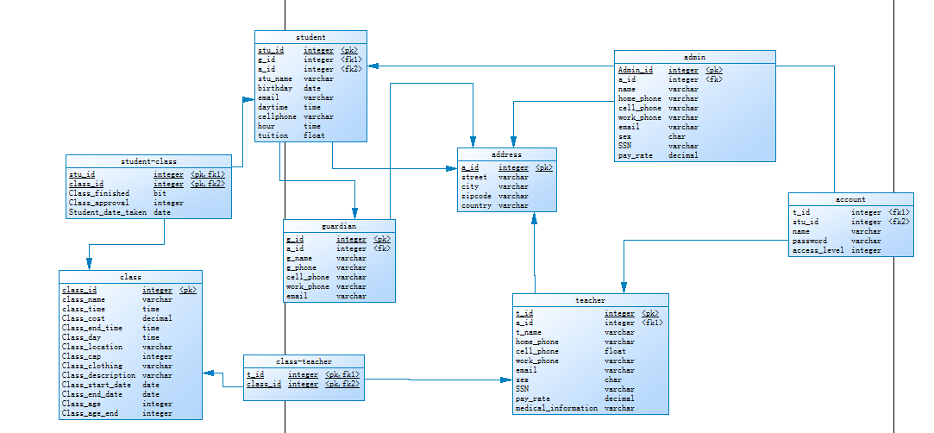
Database Architecture

Slide 5
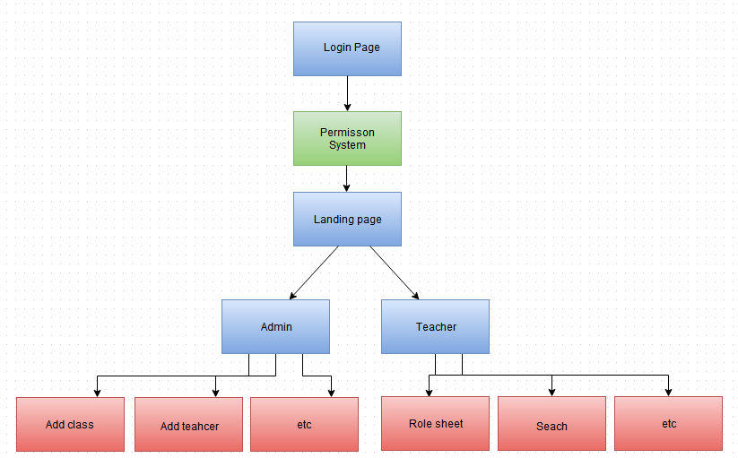
GUI Architecture

Slide 6
User Stories
User Stories worked on since new semester:
Payroll and Billing
Calculating Student Tuition
Teacher Hours
Etc..
Student Registration
Added after student interface was dropped from requirements,
Bug Fix and Quality Updates

Slide 7
Backlog Since Semester
Quality of life updates
Removal Function to maintain database
Teacher Hours/Payment
Credits and Refunds for classes
Student/Family Billing and payments
Registration
Fix Bugs

Slide 8
Remaining Backlog
Remaining client request
Student Registration
Secure the system
Final deployment
Clean up and quality of life updates
Interfaces
Help Guides/User Guide
Other request from client
Testing and Design Fair Presentation

Slide 9
Current Testing Procedure
Some interior code testing like SQL Query within code
Most testing for the project in its current form is manual GUI testing
Taking a page testing functionality and looking at the database result or modification needs.
Most test were database interactions and then checking for correct results.
Final Testing:
Start from opening of system down
Confirmation that all requirements can be accomplished within system
Find small bugs or needed quality updates

Slide 10
Prototype/Demo

Slide 11
Project Update
Updates since last presentation:
Dropped Student Interface
Added User Stories to compensate
Billing Functions
Bug Fixes
Quality of Life Update
Final Requirements/ Updates

Slide 12
Tool and Budget Update
Tools:
Xcode and Python IDE
Github and Trello
PyQt
MySQL
No budget currently - Box budget not currently decided
Intellectual Property: All open source, licensed under PyQt’s special GPL.

Slide 13
Successes and Failures
Successes:
On track to deliver final project
Team worked effectively overall
Got project to a internal testing state (proof of function state)
Failures:
Small bugs to be fixed before final
Never really got ahead on sprints
Team let other obligations interfere with team efficiency at times outside of meetings

Slide 14
Risk and Mitigation
Usability:
Continue to keep interfaces as simple as possible for user, while not compromising the wanted functionality
Retrieval of information and easy to use
Data backup
Backup database in local machine and Linux box.
Security
Encryption of the data
Protect user data

Slide 15
The Last Sprint
Clean up GUI work
Bug Fixes
Last Minute Client Request/Updates
Final Testing
Client Confirmation and Final Production
Design Fair Preparation
Finalize Documentation and User Guide

Slide 16
Final Review and Deliverables
The DanceSoft Project
The Final Documents
Design Fair Presentation

Slide 17
Any Questions?

